Slide 1


Compressed EWK study(ISRC1N2)
Department of Physics, Shandong University
Chengxin Liao
liaocx@ihep.ac.cn
May, Wed 14, 2025

Slide 2
Tasklist
PAR slides already upload(some figures need to update)
Prepare graduation defense in next week(no exactly date)
BSc thesis: https://www.overleaf.com/project/674e7119837a2580151a0868 (Fill the blank area left before, submit before graduation defense)
Chengxin Liao
IHEP SUSY Meeting

Slide 3
Backup

Slide 4
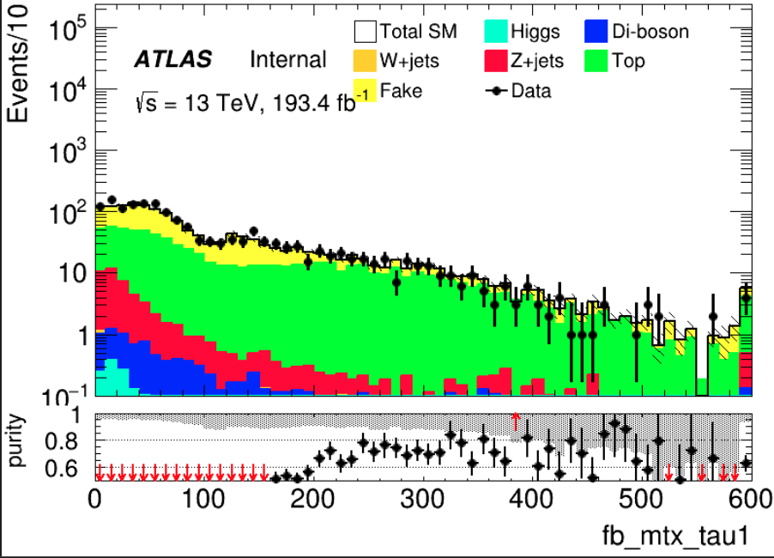
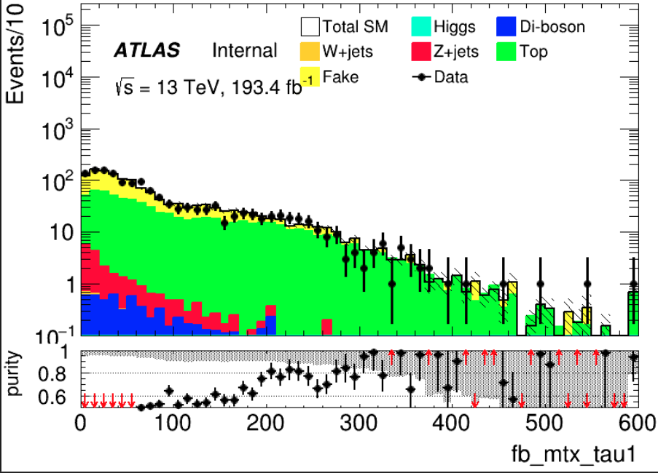
Top(HH) Binary
== 2 medium tau == 0 lepton METtrig && MET >= 200 OS nBaseJet >= 1
Jet pt > 100GeV Mtt_reco < 40GeV && Mtt_reco > 130GeV
>= 1 bTag(improve top events) mtx_tau1 >= 200(to improve top purity) CR: C1N2 score <= -0.8 VR: -0.8 <= C1N2 score <= 0.7
CR after score cut
Same with pre-selection
VR after score cut
Region | TotalBkg | Top | purity | Data | Data/Bkg
CR | 290.841+-7.459 | 206.202+-4.807 | 0.709 | 264 | 0.91
VR | 162.58+-5.438 | 131.125+-3.869 | 0.806 | 161 | 0.99
1
Chengxin Liao
IHEP SUSY Meeting

Slide 5
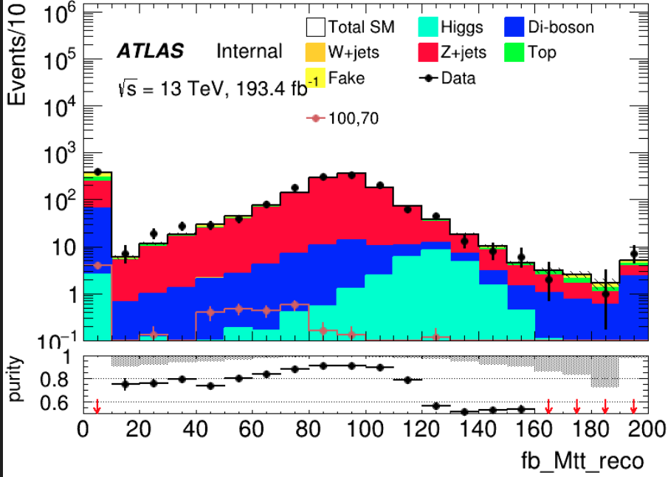
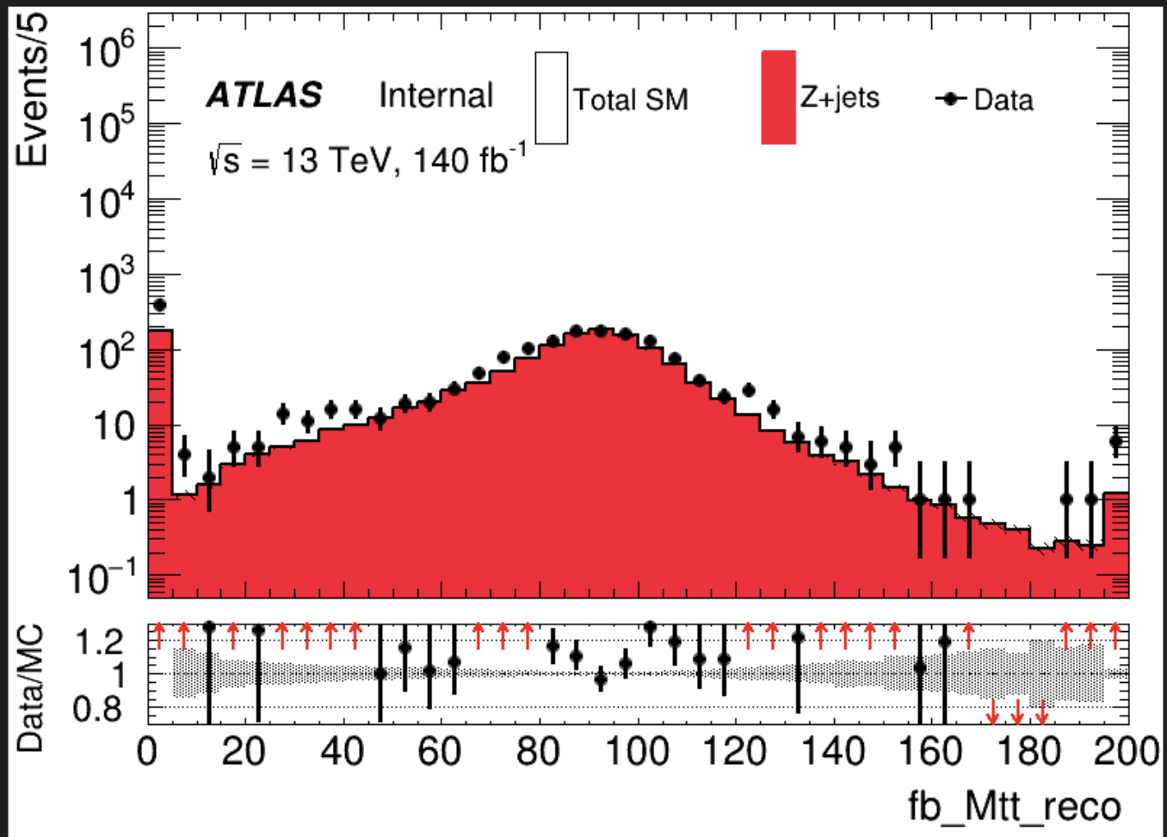
Zjets(LH) Binary
== 1 medium tau >= 1 lepton METtrig && MET >= 200 OS
bVeto nBaseJet >= 1
Jet pt > 100GeV dRtt <= 0.6(improve purity of Zjets) C1N2 score <= 0.7(Othrogonal with SR) CR: Mlt reco >= 80 && Mlt reco <= 110 VR: (Mlt reco >= 40 && Mlt reco < 80) || (Mlt reco > 110 && Mlt reco < 130)
Same with pre-selection
Region | TotalBkg | Zjets | purity | Data | Data/Bkg
CR | 917.505+-6.668 | 823.435+-4.028 | 0.897 | 908 | 0.99
VR1 | 592.091+-5.617 | 518.684+-3.244 | 0.876 | 635 | 1.07
VR2 | 128.617+-2.384 | 87.882+-1.217 | 0.683 | 120 | 0.93
VR | 720.708+-6.102 | 606.566+-3.464 | 0.842 | 745 | 1.034
Merge them to one VR
2
Chengxin Liao
IHEP SUSY Meeting

Slide 6
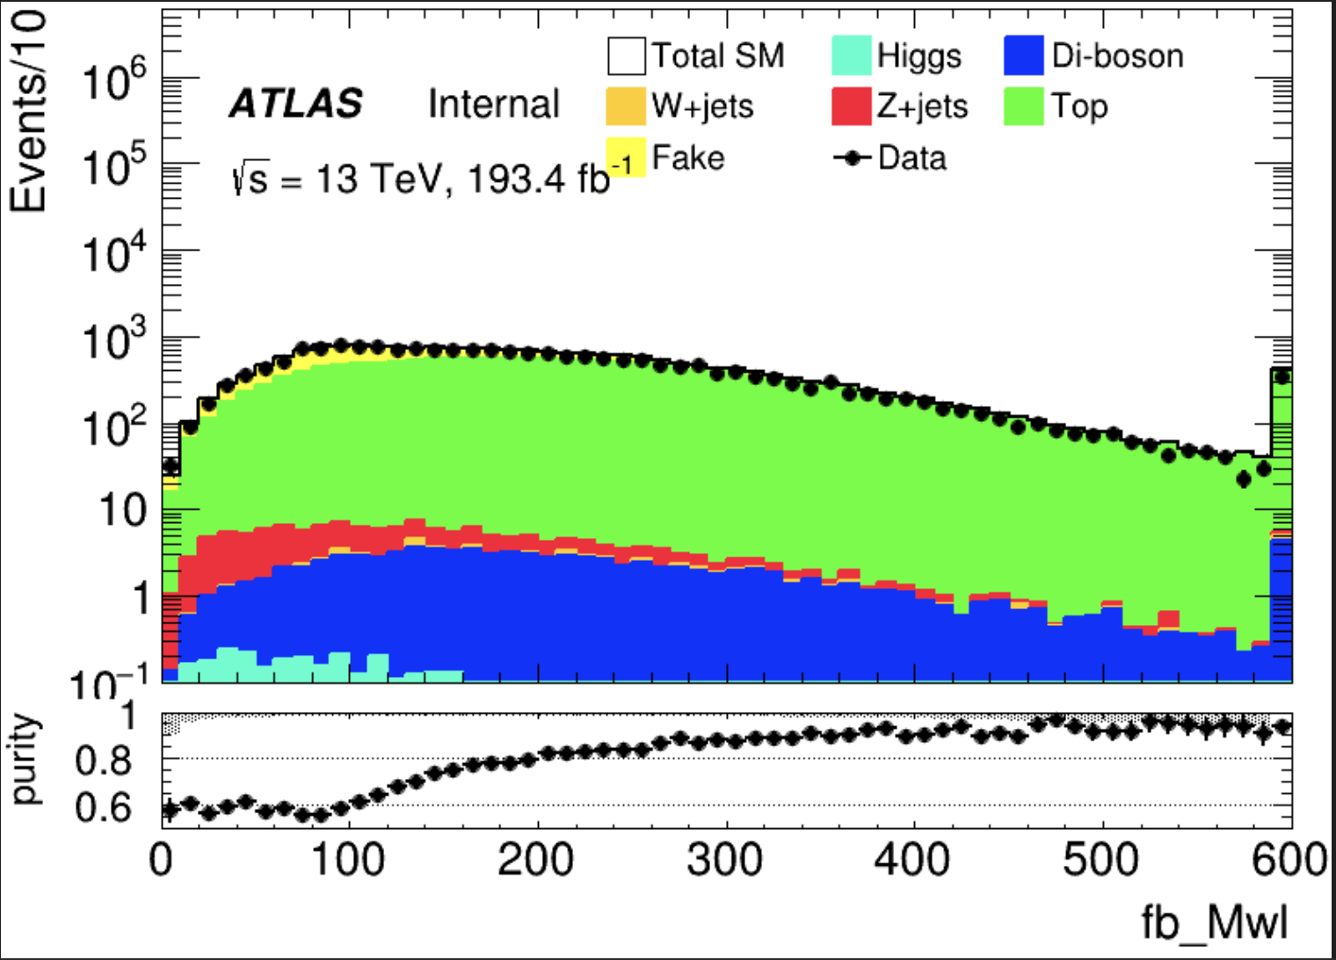
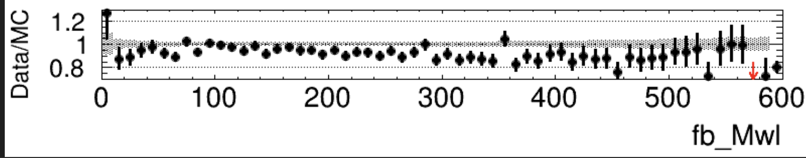
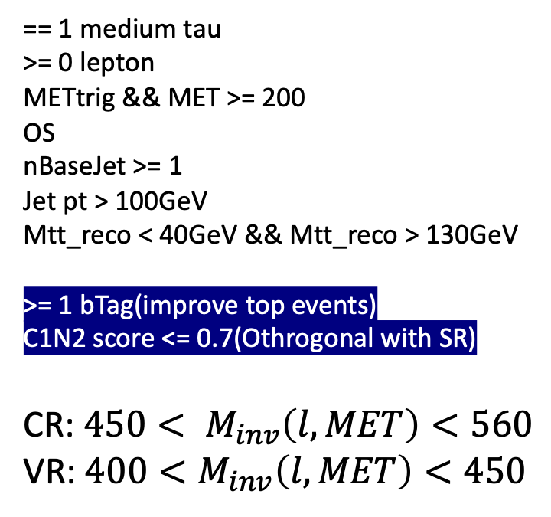
Top(LH) Binary
== 1 medium tau >= 0 lepton METtrig && MET >= 200 OS nBaseJet >= 1
Jet pt > 100GeV Mtt_reco < 40GeV && Mtt_reco > 130GeV
>= 1 bTag(improve top events)
C1N2 score <= 0.7(Othrogonal with SR) CR: ${450< M}_{inv}\left(l, MET\right)<560$ VR: $400<M_{inv}\left(l, MET\right)<450$
Same with pre-selection
Try to define by using C1N2 score
Region | TotalBkg | Top | purity | Data | Data/Bkg
CR | 888.156+-11.505 | 830.914+-9.676 | 0.935 | 785 | 0.884
VR | 902.627+-11.837 | 828.424+-9.679 | 0.912 | 792 | 0.878
3
Chengxin Liao
IHEP SUSY Meeting

Slide 7
Introduction
Reference point: C1 mass = 100GeV, N2 mass = 70 GeV
SR optimization: BDT method, optuna to auto-optimize hps
For FF method constriant
HH Pre-Selection
LH Pre-Selection
Had-Had channel: nBaseTau=2; nMediumTau=2; nLeps=0
MET >= 200, MET trigger
Opposite-sign hadronic tau pair
bVeto Mtt_reco < 40GeV && Mtt_reco > 130GeV nBaseJet >= 1
Jet pt > 100GeV
Had-Had channel: nBaseTau=1; nMediumTau=1; nLeps>=1
MET >= 200, MET trigger
Opposite-sign hadronic tau pair
bVeto Mtl_reco < 40GeV && Mtl_reco > 130GeV nBaseJet >= 1
Jet pt > 100GeV
1
Chengxin Liao
IHEP SUSY Meeting

Slide 8
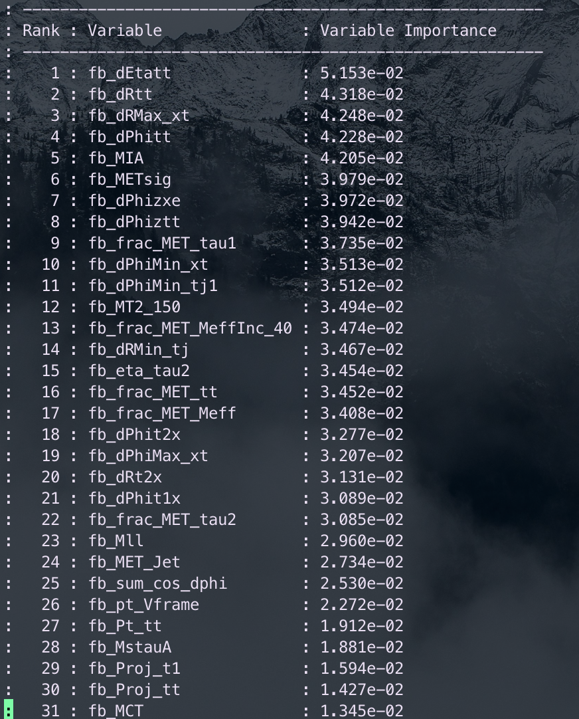
Binary class(HH)
Hyperparameters: Ntrees = 200, MaxDepth = 6, MinNodeSize = 2%, Learning rate = 0.03(initial setting)
Feature engineering: Select a simple model and put all features into model, choose Top 30 vars based on importance list, drop high correlated vars Final feature list:
Weight choose: no weight, abs(weight)
No weight have better performance but abs(weight) fit our anaysis requirment
Split strategy: Separate entries by using mod 5, for Fake bkg, if separate follow sequence, all weighted entry will split into first fold
2
Chengxin Liao
IHEP SUSY Meeting

Slide 9
Binary class(HH)
Class: C1N2, bkg
Hyperparameter tune: use optuna to auto-optimze
Test_auc = \sum{Test_auc_class} Train_auc = \sum{Train_auc_class}
constraint: average of AUC need to >= 0.6 penalty function: score = test_auc – 0.3*auc_gap (auc_gap = abs(train_auc- test_auc)) maximum(score)
Grid Search Ntrees: [200, 300, 400]
MaxDepth: [4, 6, 8, 10] MinNode: [1, 3, 5, 7]
Learning rate: [0.001, 0.005, 0.01, 0.05, 0.1]
Best one: Ntree=300, MaxDepth=6, MinNode=1%, Learning Rate=0.05
There still have rooms to optimize for lr
3
Chengxin Liao
IHEP SUSY Meeting

Slide 10
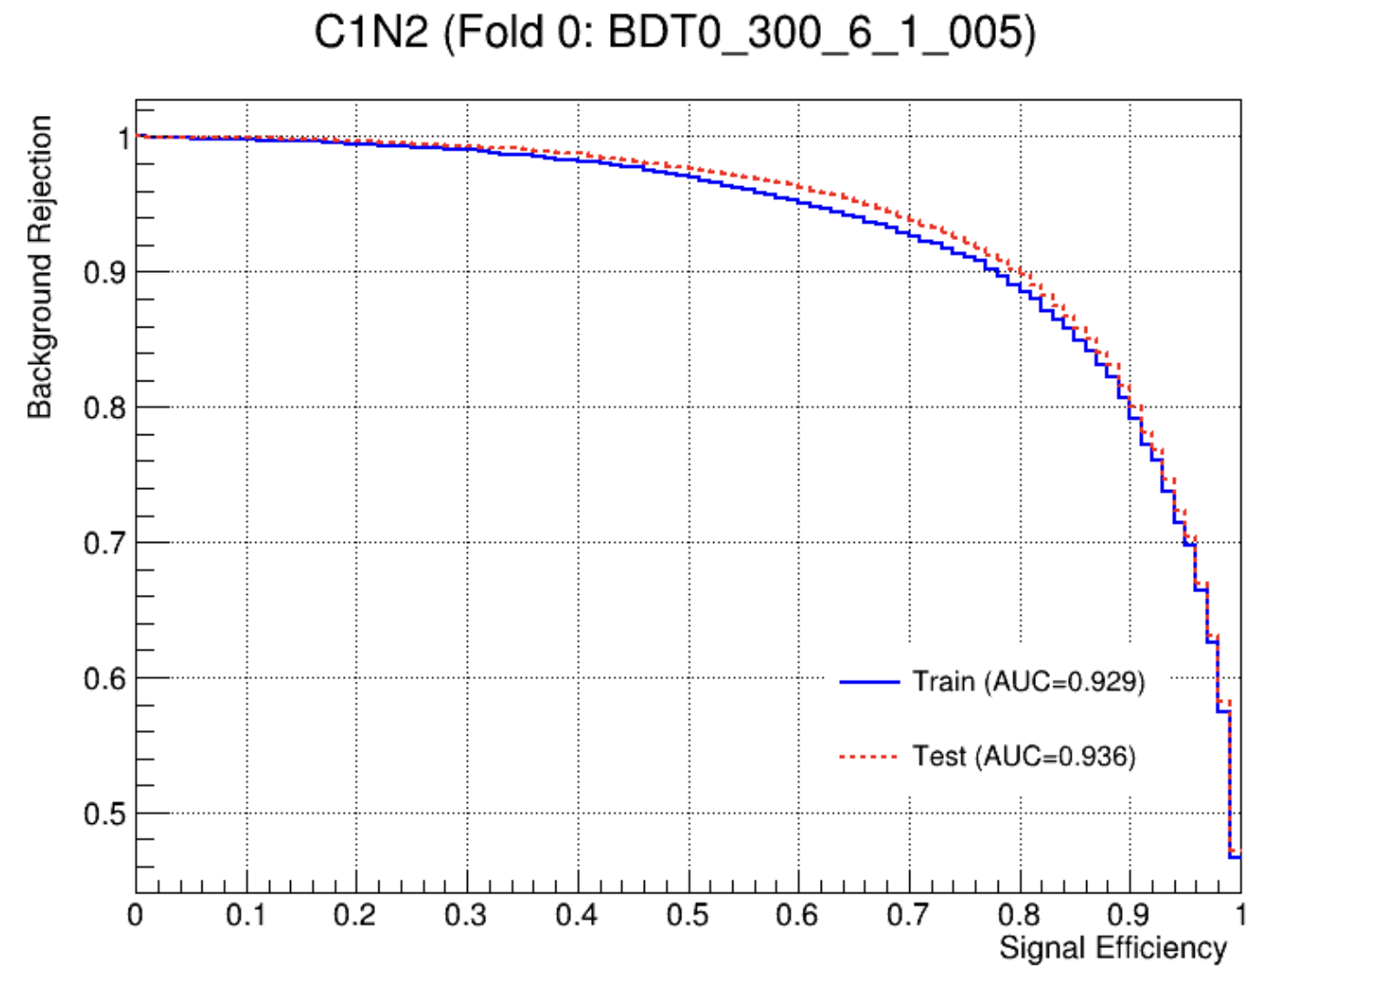
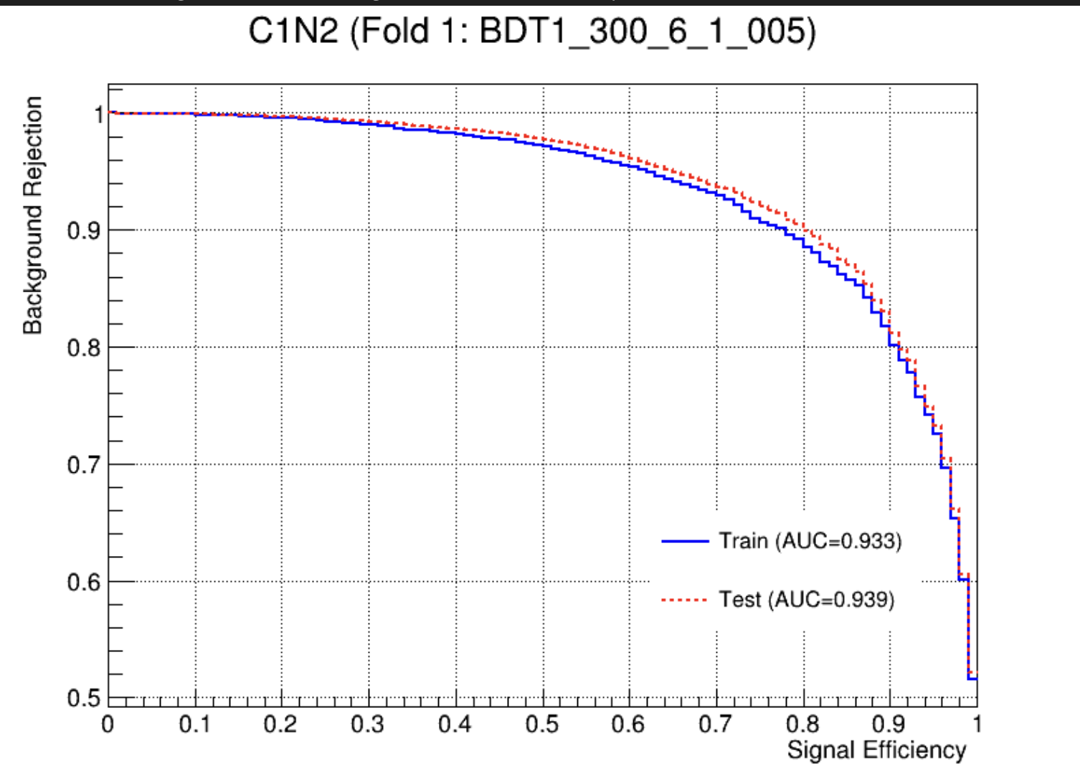
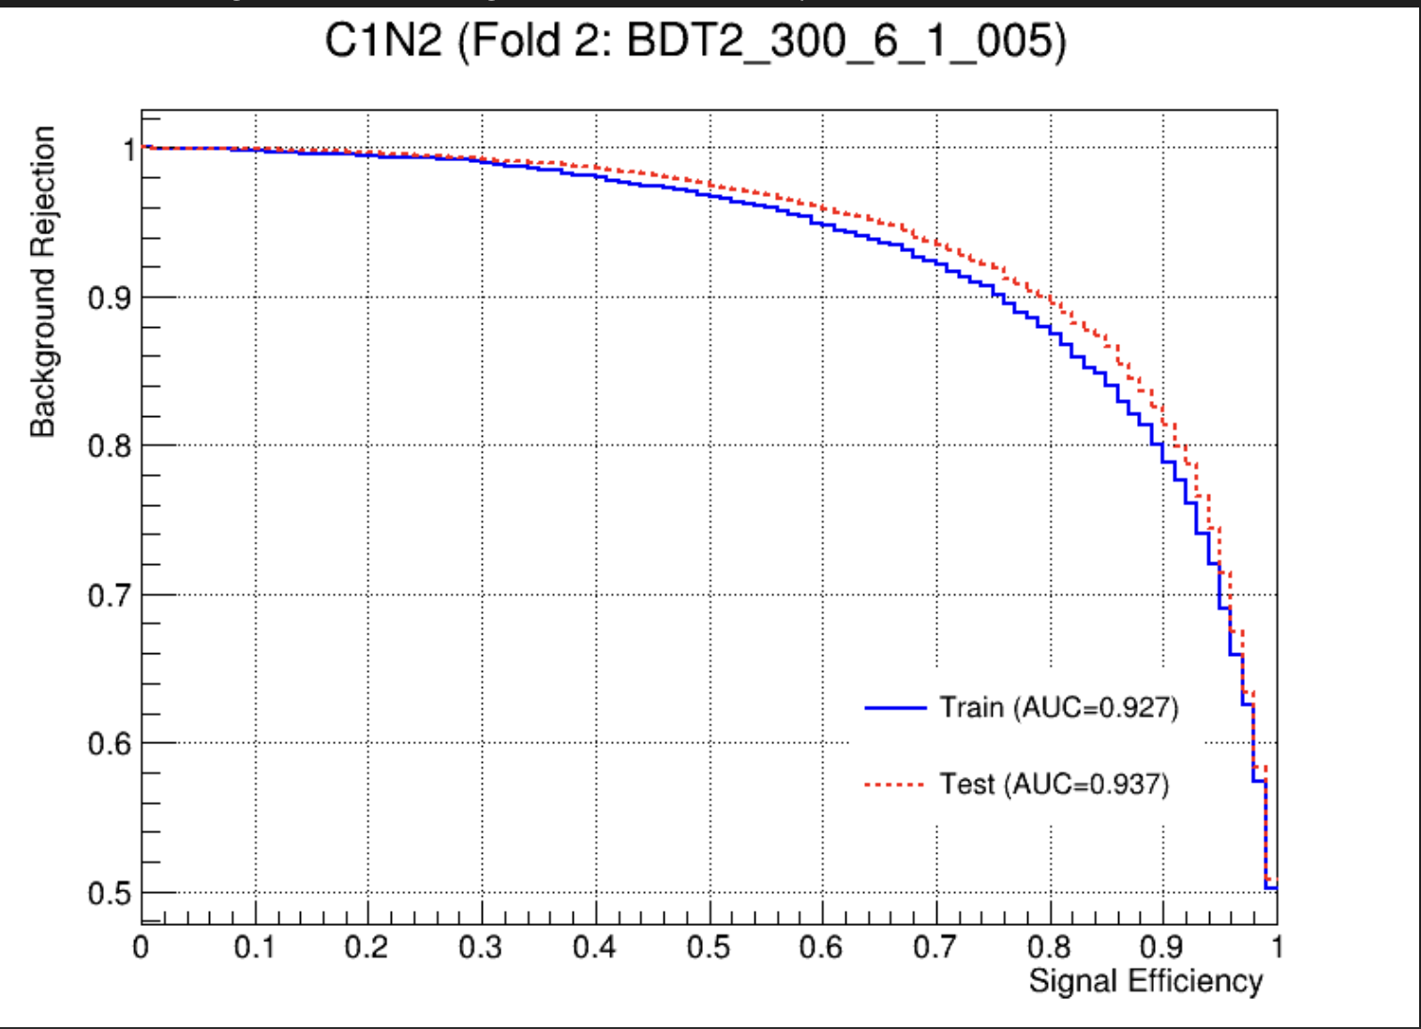
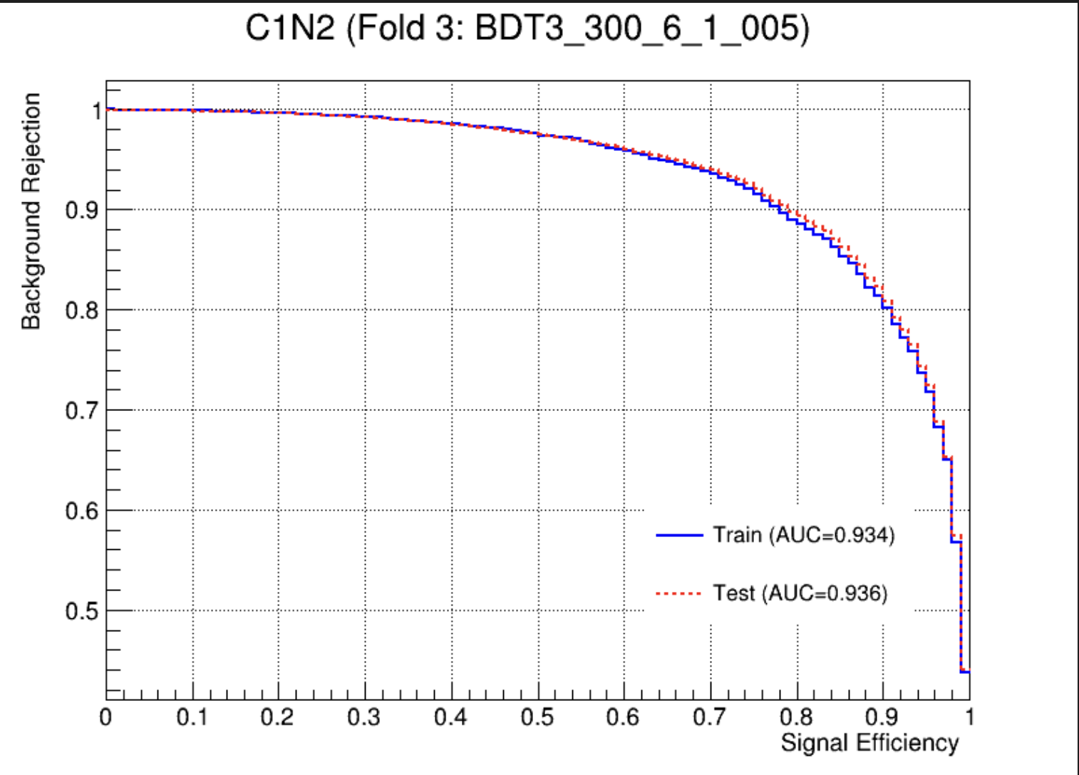
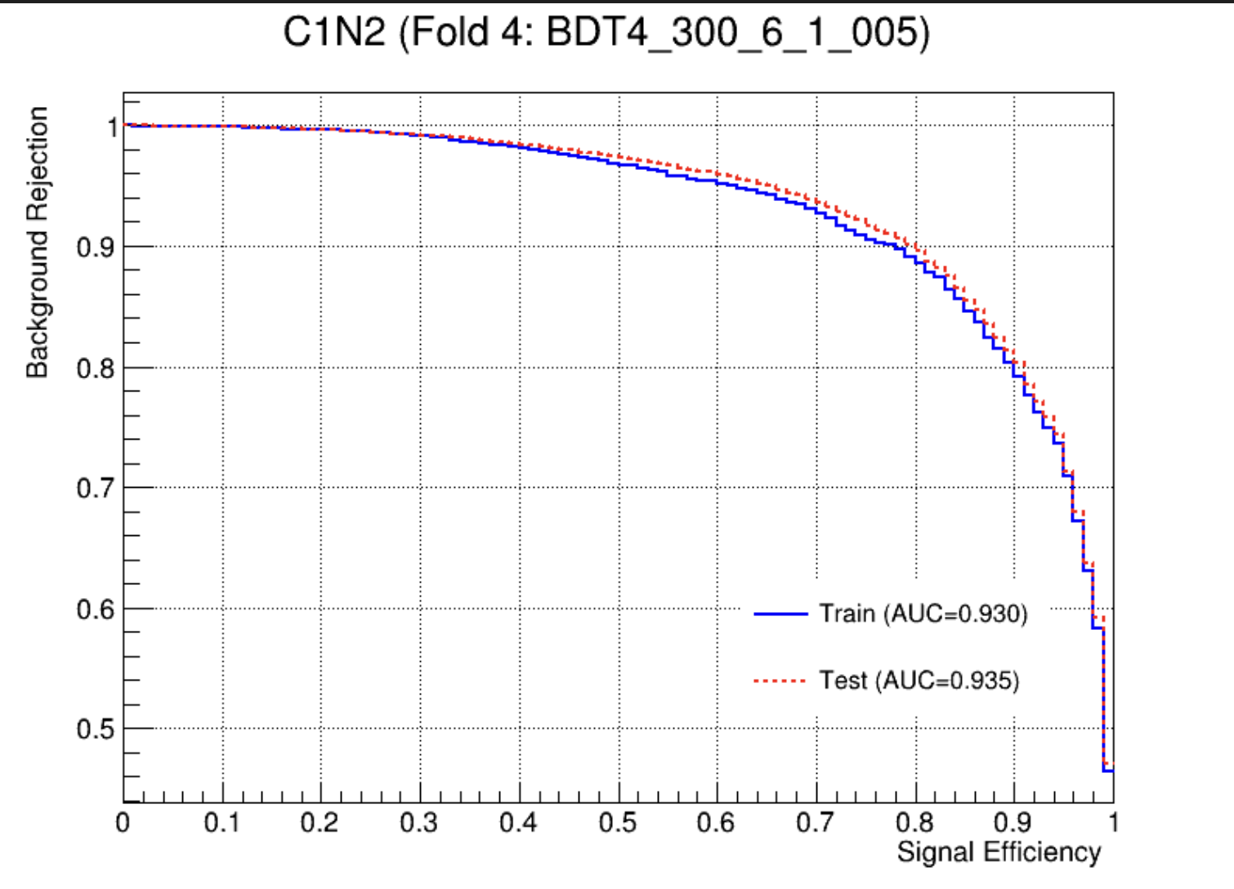
Binary class(HH)
Overfit Check
4
Chengxin Liao
IHEP SUSY Meeting

Slide 11
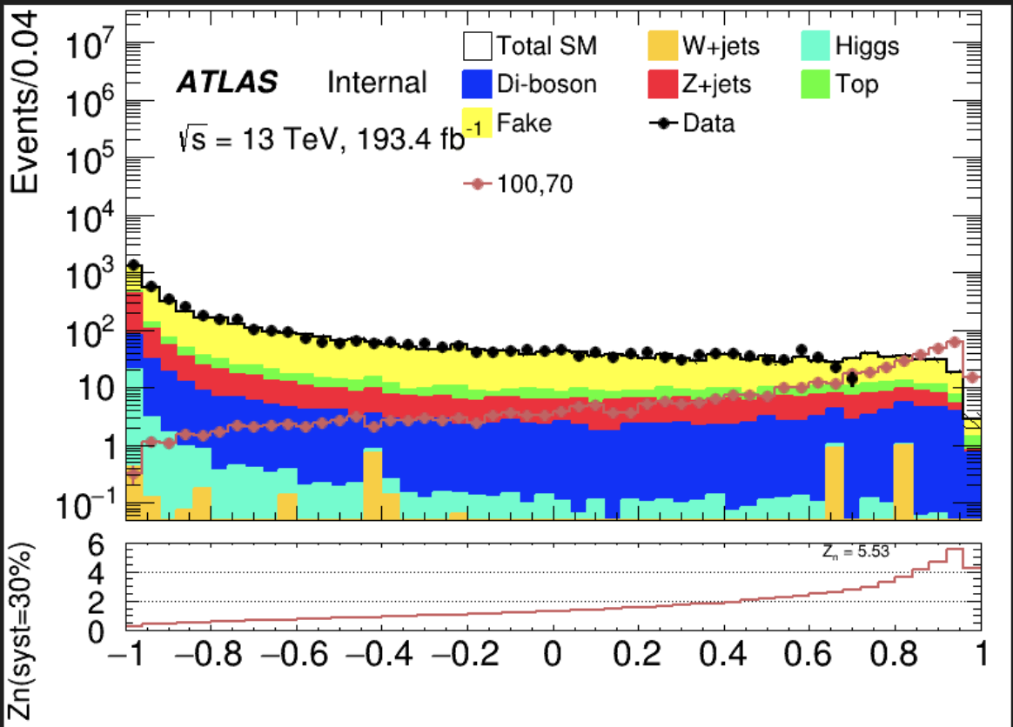
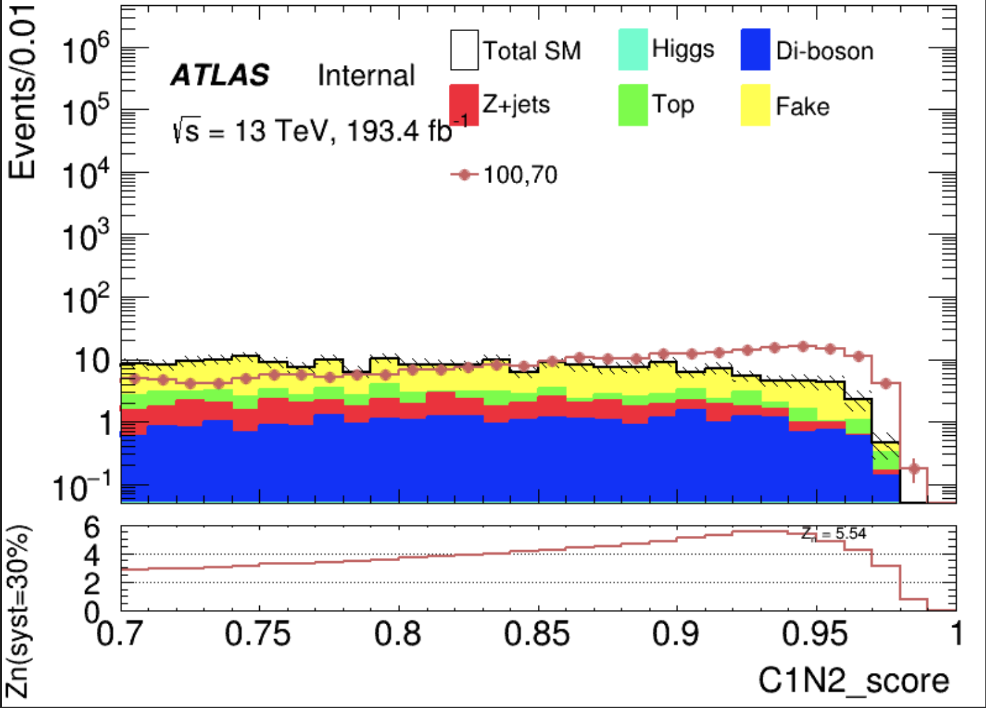
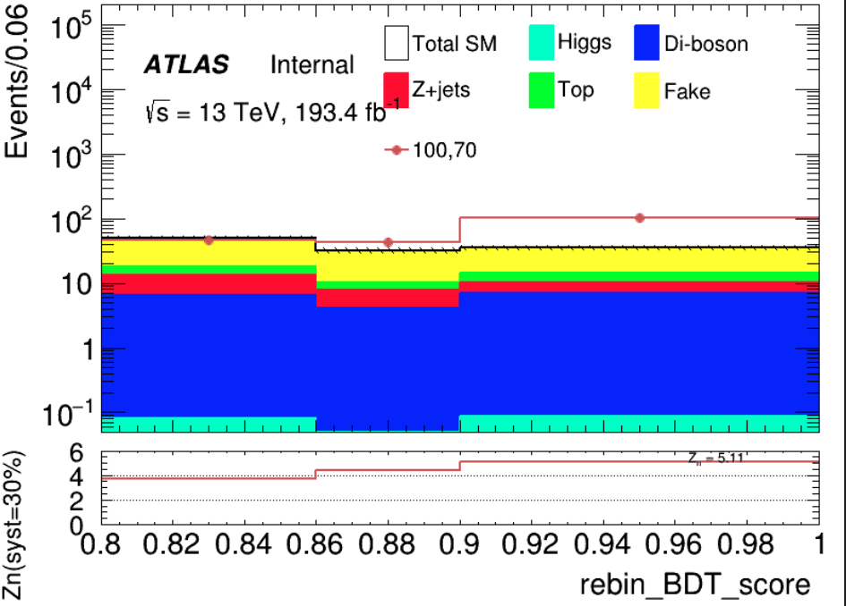
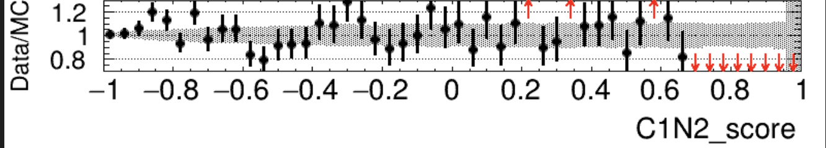
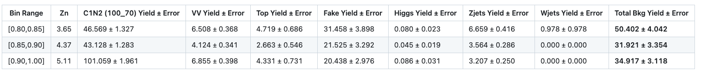
SR(HH) Binary
50 bins
Cut at 0.8
rebin
Sum Zn = 7.65
5
Chengxin Liao
IHEP SUSY Meeting

Slide 12
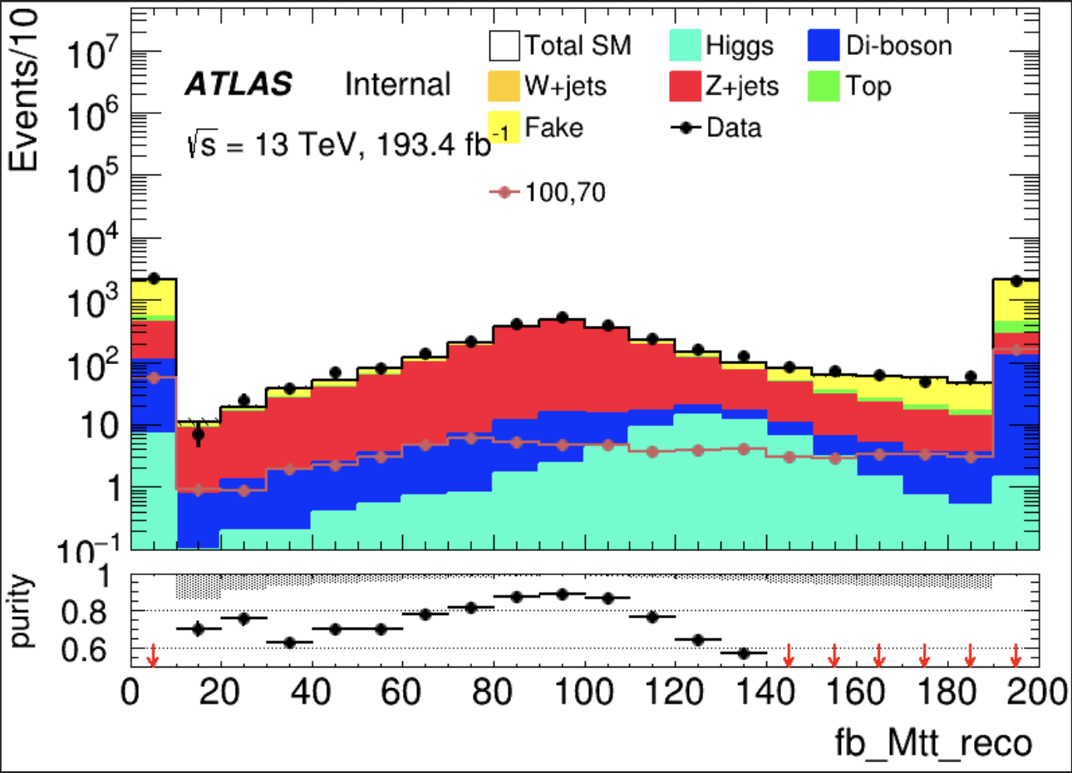
Zjets(HH) Binary
== 2 medium tau == 0 lepton METtrig && MET >= 200 OS
bVeto nBaseJet >= 1
Jet pt > 100GeV C1N2 score <= 0.7(Othrogonal with SR)
CR: Mtt reco >= 80 && Mtt reco <= 110 VR: (Mtt reco >= 40 && Mtt reco < 80) || (Mtt reco > 110 && Mtt reco < 130)
Same with pre-selection
Region | TotalBkg | Zjets | purity | Data | Data/Bkg
CR | 1420.2+-10.9304 | 1221.51+-5.434 | 0.860 | 1559 | 1.09
VR1 | 821.998+-9.435 | 673.277+-4.073 | 0.819 | 904 | 1.10
VR2 | 465.375+-7.800 | 320.194+-2.908 | 0.688 | 523 | 1.12
6
Chengxin Liao
IHEP SUSY Meeting

Slide 13
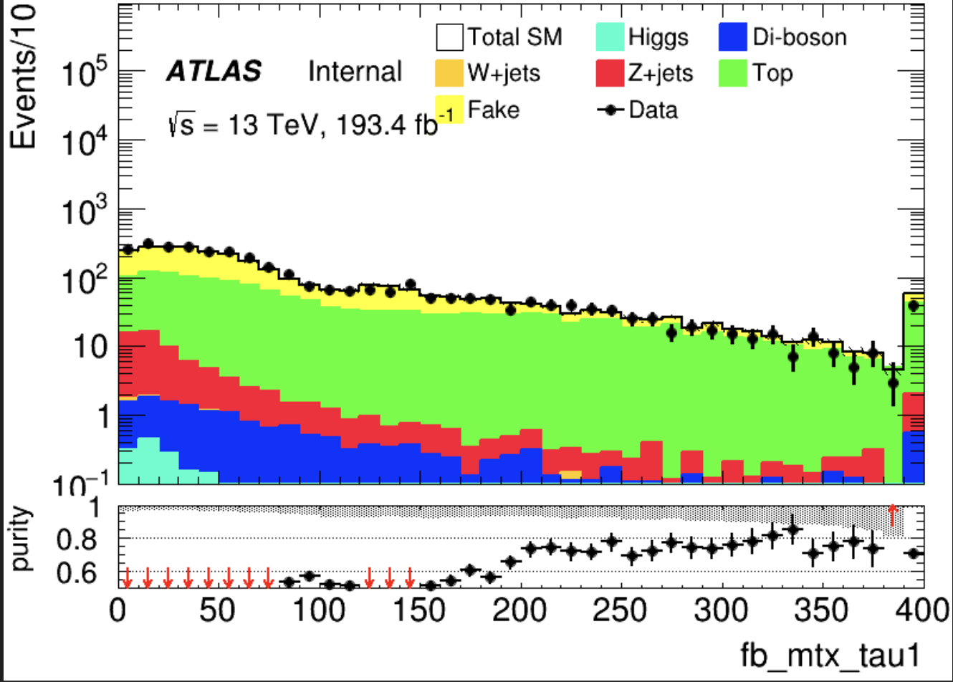
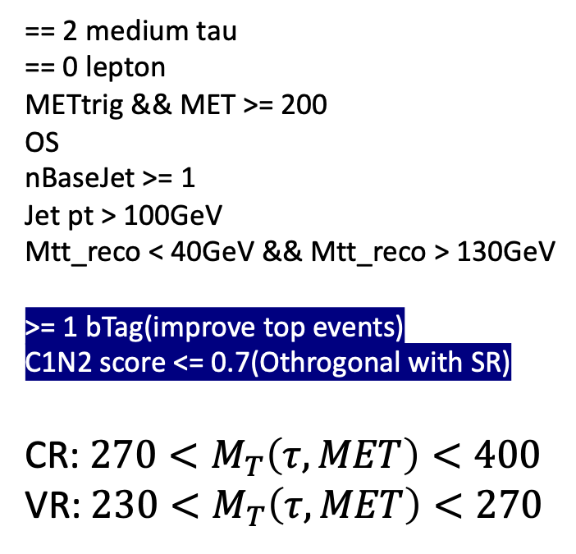
Top(HH) Binary
== 2 medium tau == 0 lepton METtrig && MET >= 200 OS nBaseJet >= 1
Jet pt > 100GeV Mtt_reco < 40GeV && Mtt_reco > 130GeV
>= 1 bTag(improve top events)
C1N2 score <= 0.7(Othrogonal with SR) CR: ${270<M}_{T}\left(τ,MET\right)<400$ VR: $230<M_{T}\left(τ, MET\right)<270$
Same with pre-selection
Huge overestimation
Region | TotalBkg | Top | purity | Data | Data/Bkg
CR | 182.692+-5.738 | 140.981+-4.009 | 0.771 | 150 | 0.82
VR | 140.228+-5.236 | 103.866+-3.445 | 0.740 | 134 | 0.94
7
Chengxin Liao
IHEP SUSY Meeting

Slide 14
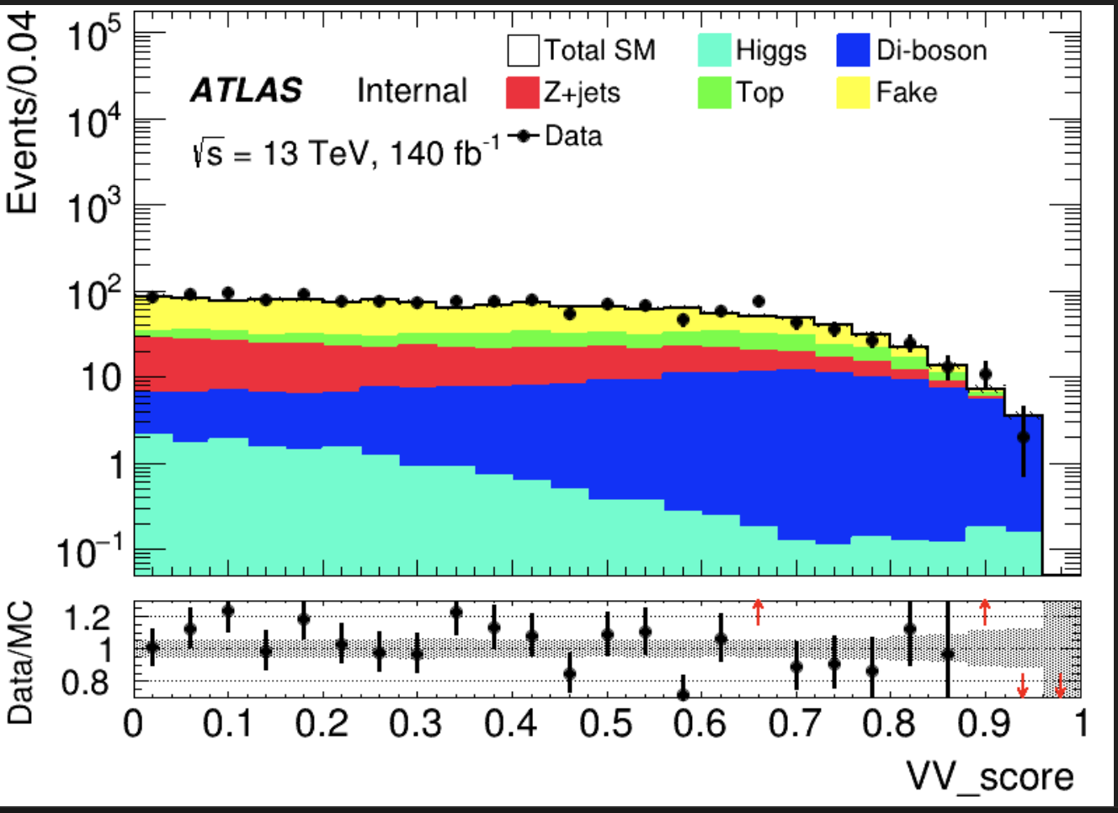
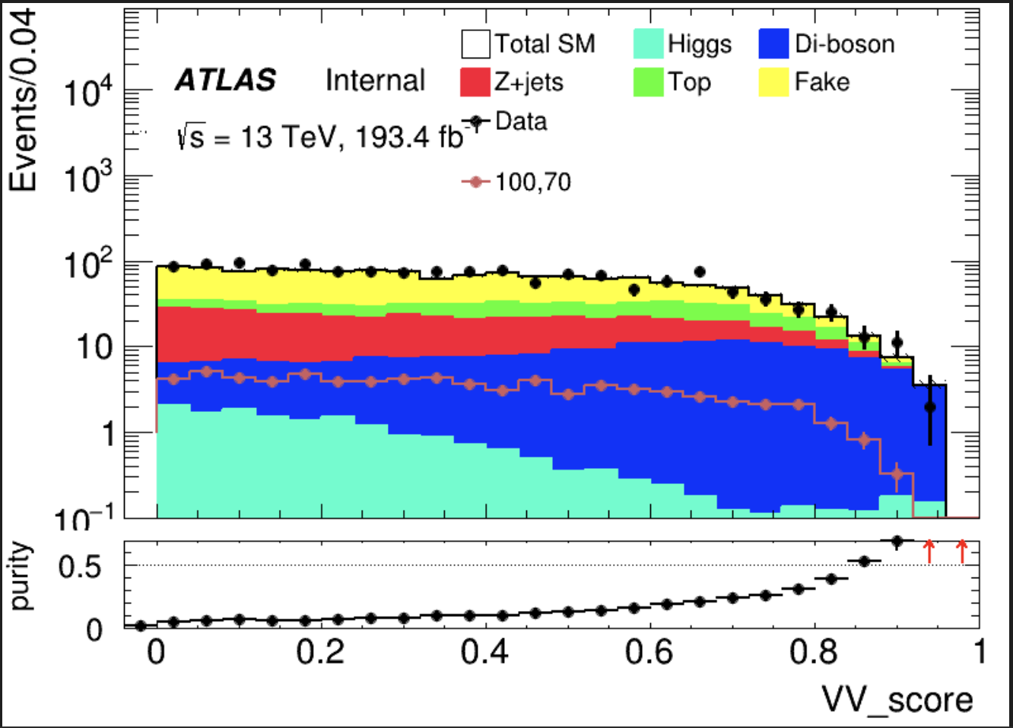
VV(HH) Binary
Pre-selection && C1N2_score <= 0.7 && VV_score >= 0.80
Region | TotalBkg | VV | purity | Data | Data/Bkg
VR | 46.6004+-2.77 | 24.193+-0.816 | 0.519 | 51 | 1.108
8
Chengxin Liao
IHEP SUSY Meeting

Slide 15
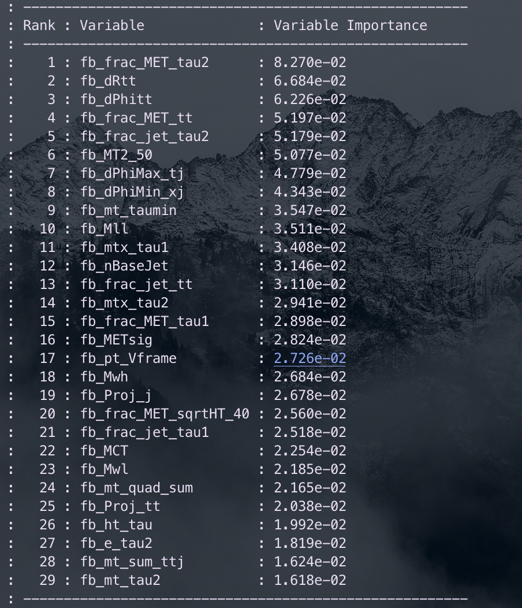
Binary class(LH)
Hyperparameters: Ntrees = 200, MaxDepth = 6, MinNodeSize = 2%, Learning rate = 0.03(initial setting)
Feature engineering: Select a simple model and put all features into model, choose Top 30 vars based on importance list, drop high correlated vars Final feature list:
Weight choose: no weight, abs(weight)
No weight have better performance but abs(weight) fit our anaysis requirment
Split strategy: Separate entries by using mod 5, for Fake bkg, if separate follow sequence, all weighted entry will split into first fold
9
Chengxin Liao
IHEP SUSY Meeting

Slide 16
Binary class(LH)
Class: C1N2, bkg
Hyperparameter tune: use optuna to auto-optimze
Test_auc = \sum{Test_auc_class} Train_auc = \sum{Train_auc_class}
constraint: average of AUC need to >= 0.6 penalty function: score = test_auc – 0.3*auc_gap (auc_gap = abs(train_auc- test_auc)) maximum(score)
Grid Search Ntrees: [200, 300, 400]
MaxDepth: [4, 6, 8, 10] MinNode: [1, 3, 5, 7]
Learning rate: [0.001, 0.005, 0.01, 0.05, 0.1]
Best one: Ntree=200, MaxDepth=8, MinNode=1%, Learning Rate=0.05
There still have rooms to optimize for lr
10
Chengxin Liao
IHEP SUSY Meeting

Slide 17
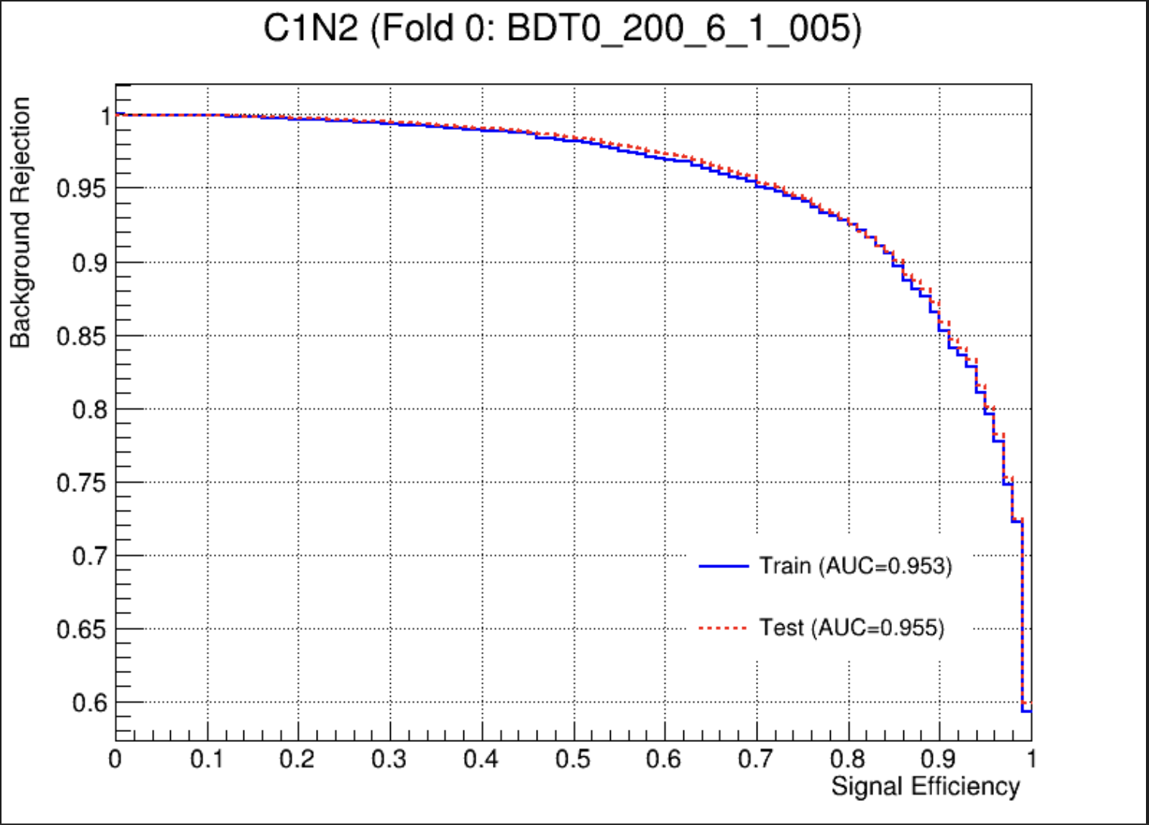
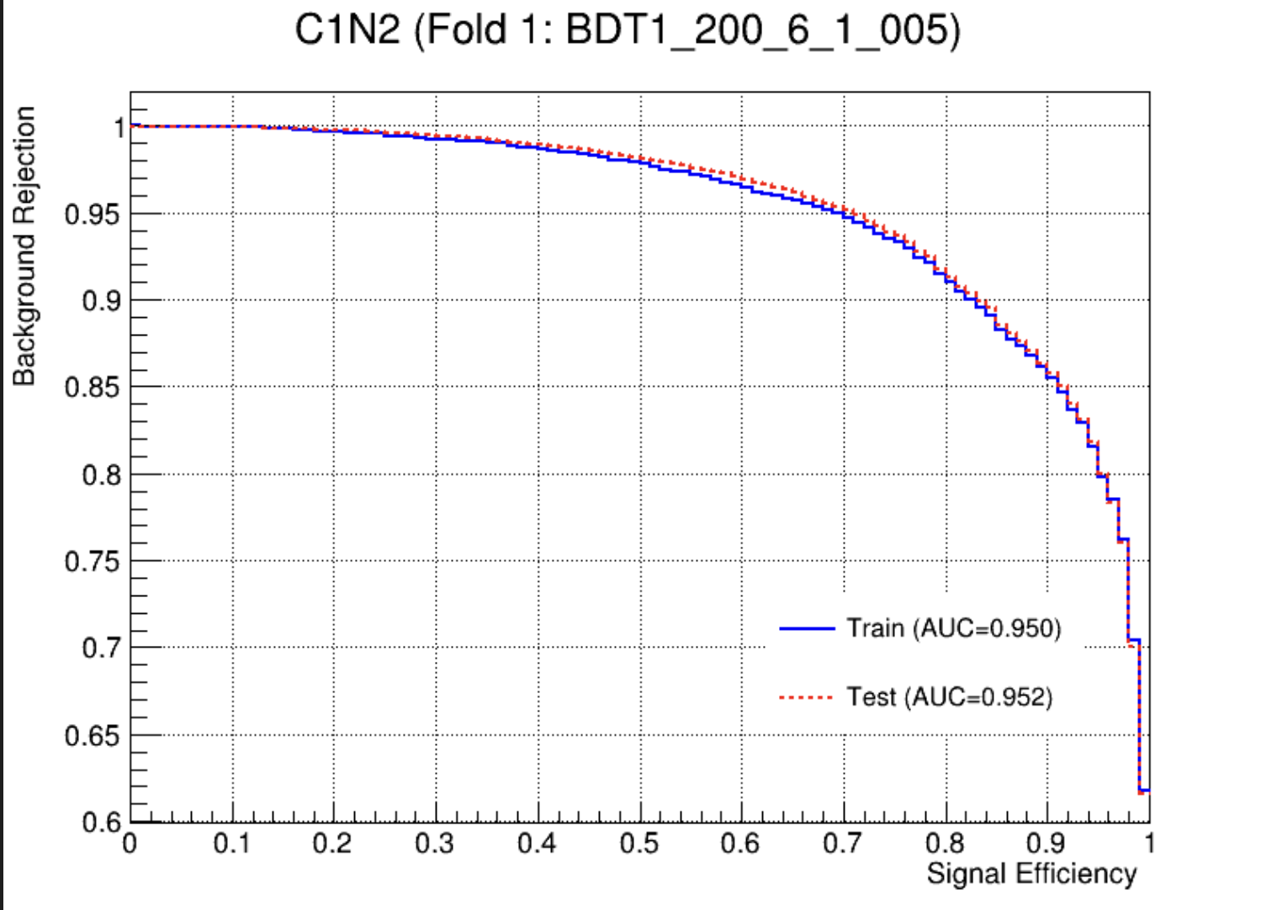
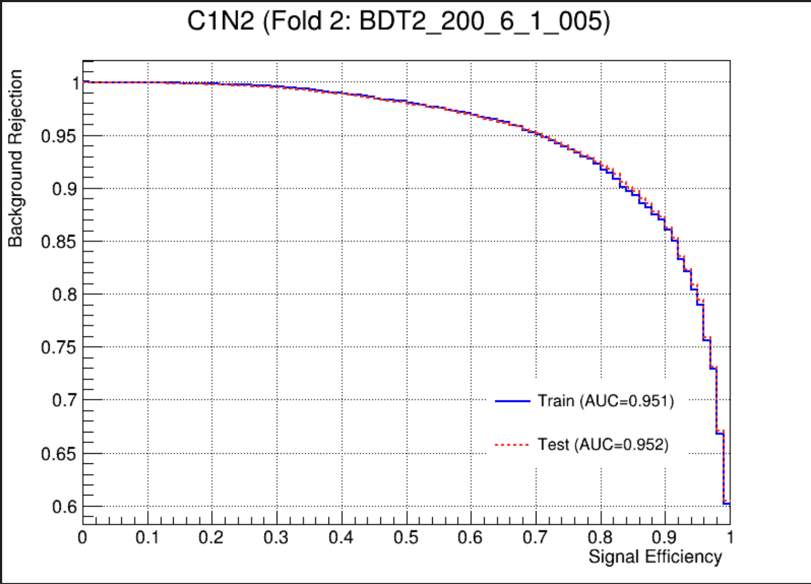
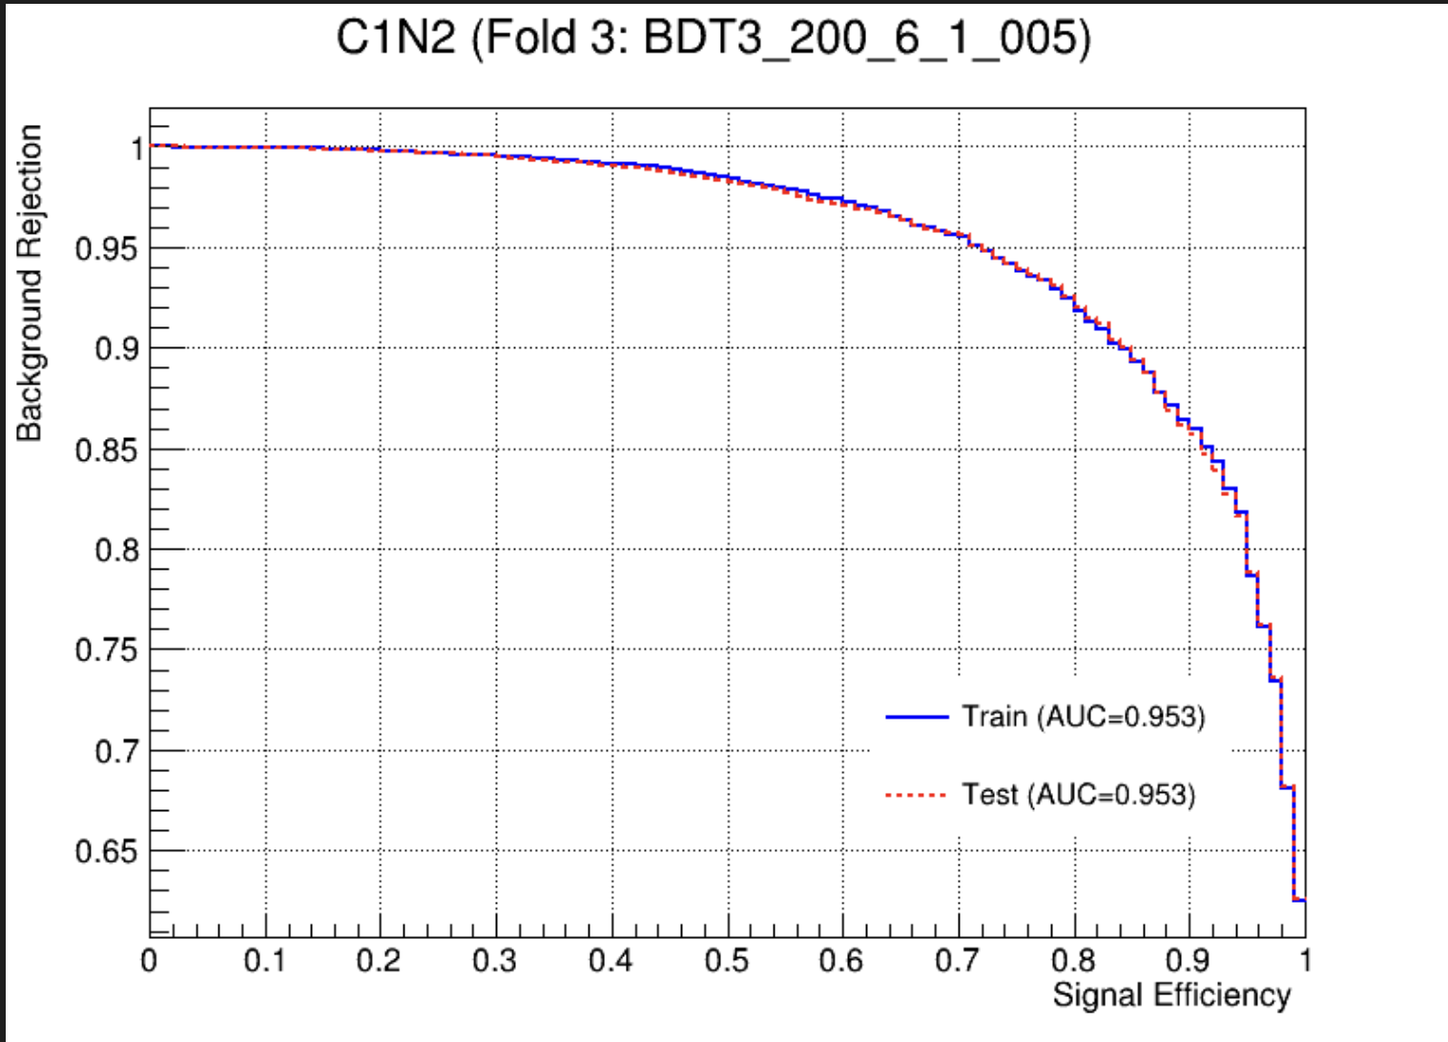
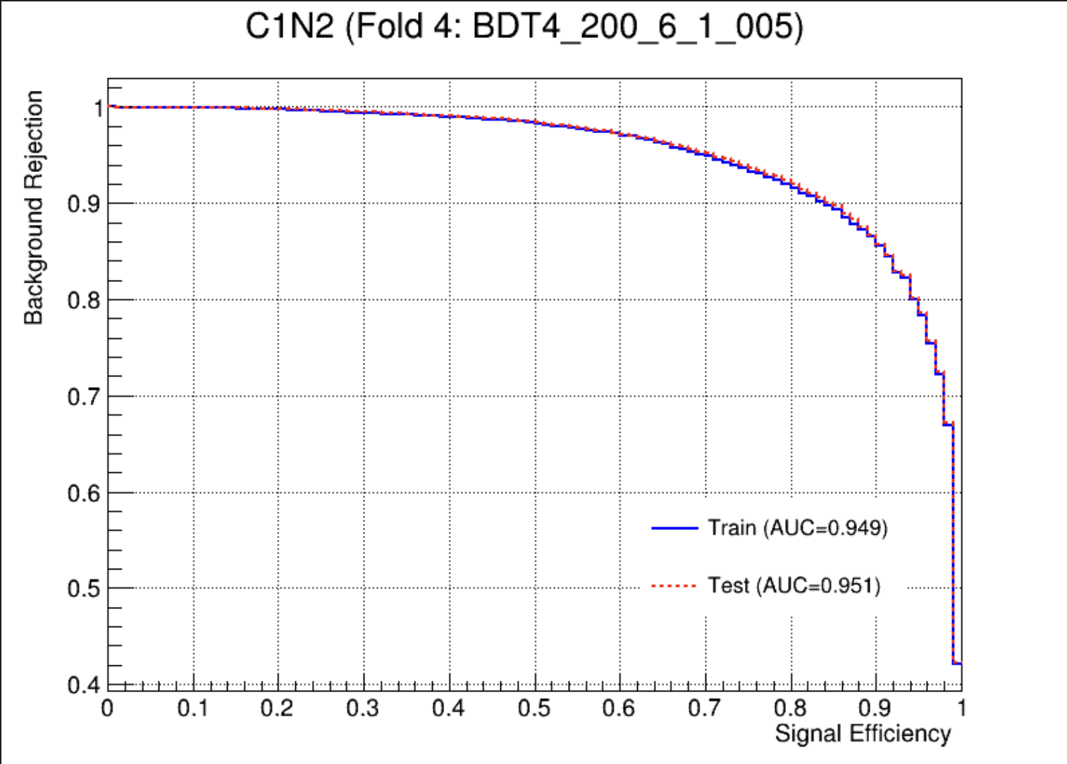
Binary class(LH)
Overfit Check
11
Chengxin Liao
IHEP SUSY Meeting

Slide 18
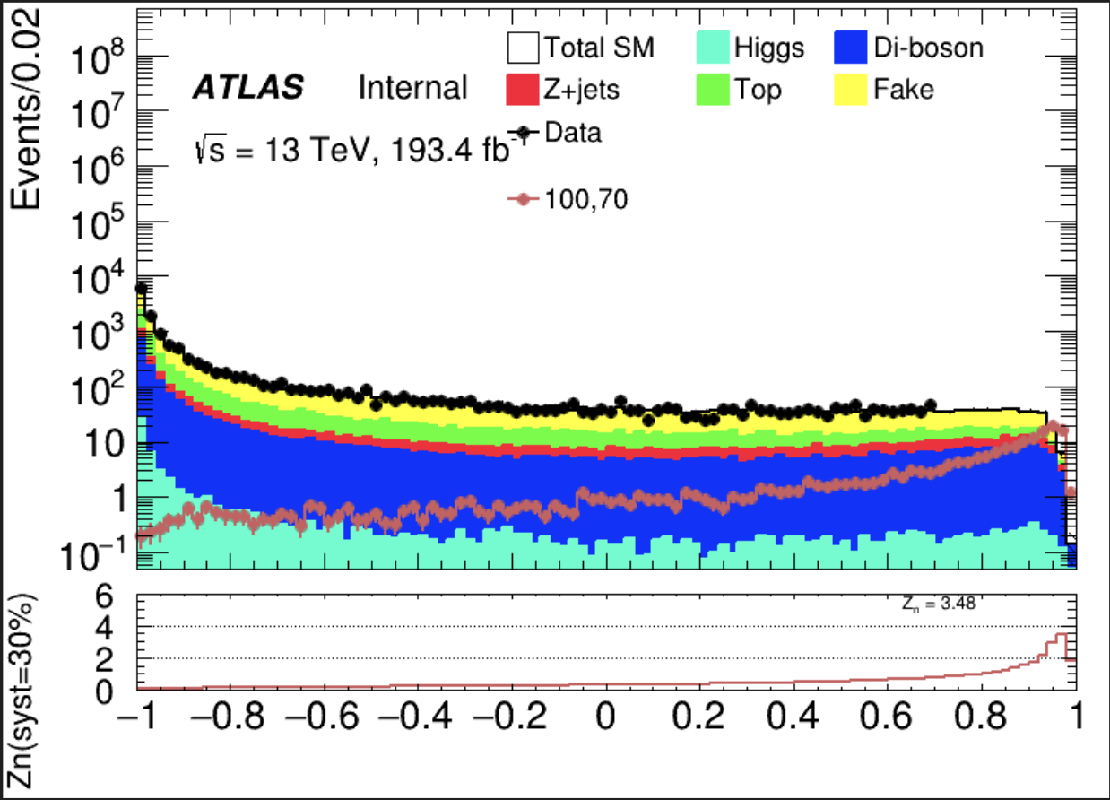
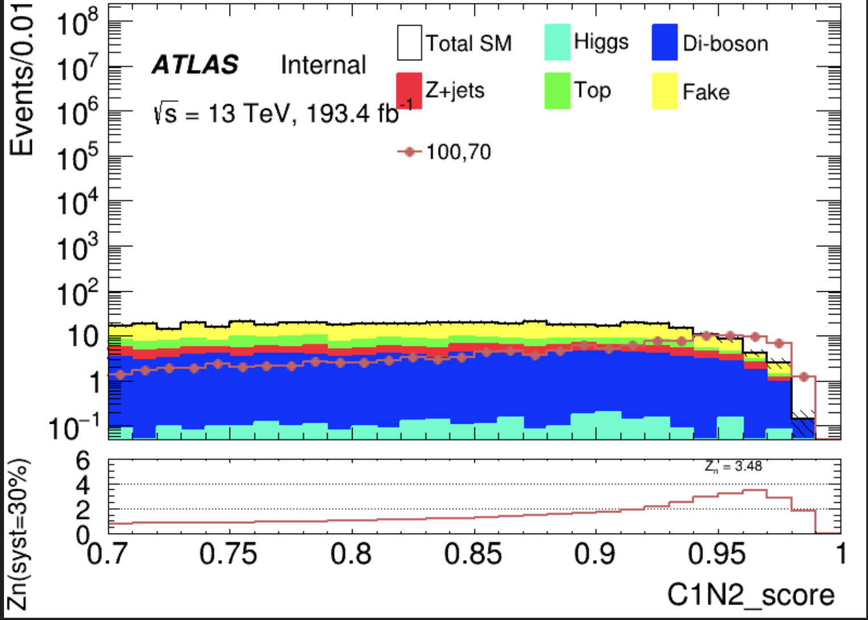
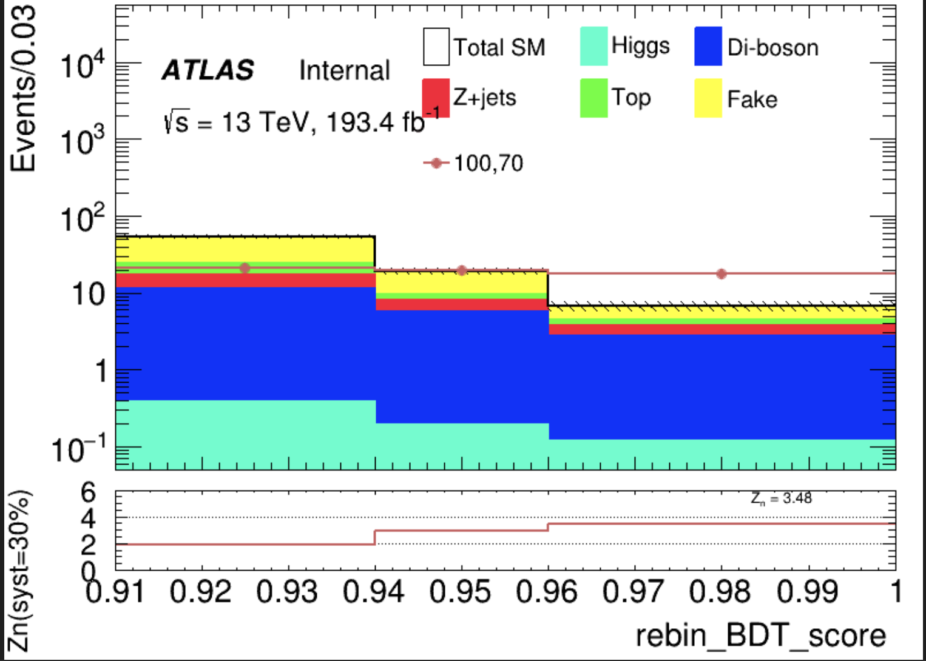
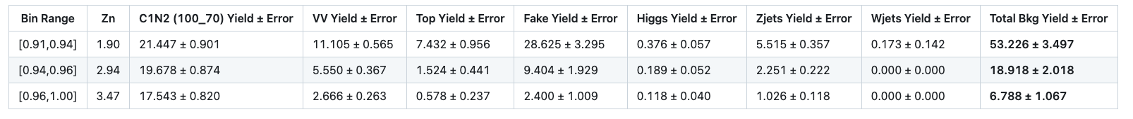
SR(LH) Binary
100 bins
Cut at 0.91
rebin
Narrow peak
Sum Zn = 4.934
12
Chengxin Liao
IHEP SUSY Meeting

Slide 19
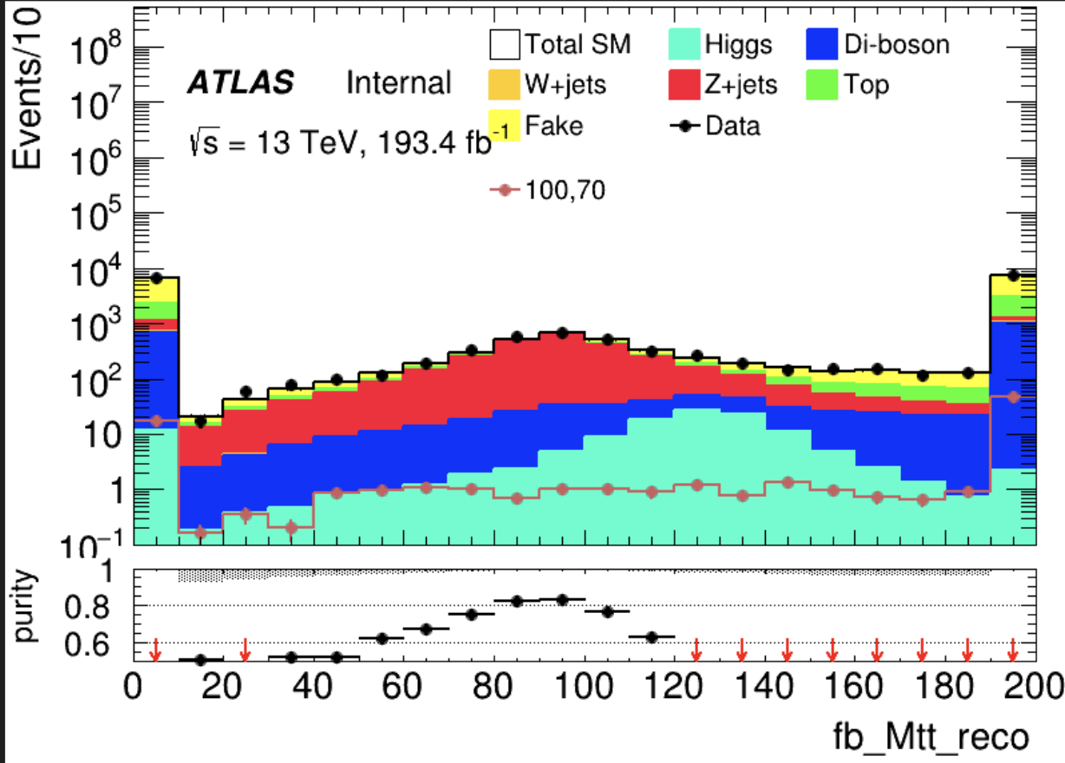
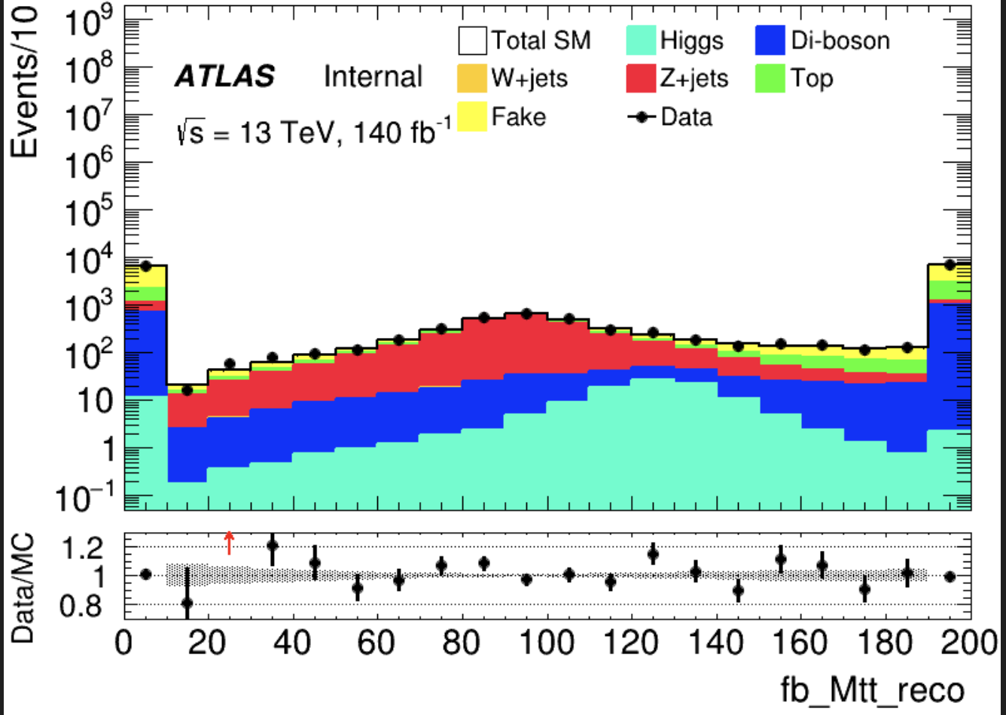
Zjets(LH) Binary
== 1 medium tau >= 1 lepton METtrig && MET >= 200 OS
bVeto nBaseJet >= 1
Jet pt > 100GeV C1N2 score <= 0.7(Othrogonal with SR)
CR: Mlt reco >= 80 && Mlt reco <= 110 VR: (Mlt reco >= 40 && Mlt reco < 80) || (Mlt reco > 110 && Mlt reco < 130)
Same with pre-selection
Region | TotalBkg | Zjets | purity | Data | Data/Bkg
CR | 2048.51+-12.873 | 1600.7+-6.313 | 0.781 | 2064 | 1.0078
VR1 | 1238.27+-10.537 | 915.681+-4.726 | 0.739 | 1296 | 1.046
VR2 | 746.998+-9.369 | 385.547+-3.280 | 0.516 | 774 | 1.037
13
Chengxin Liao
IHEP SUSY Meeting

Slide 20

Top(LH) Binary
== 1 medium tau >= 0 lepton METtrig && MET >= 200 OS nBaseJet >= 1
Jet pt > 100GeV Mtt_reco < 40GeV && Mtt_reco > 130GeV
>= 1 bTag(improve top events)
C1N2 score <= 0.7(Othrogonal with SR) CR: ${300< M}_{inv}\left(l, MET\right)<550$ VR: $250<M_{inv}\left(l, MET\right)<300$
Same with pre-selection
Huge overestimation
Region | TotalBkg | Top | purity | Data | Data/Bkg
CR | 4657.04+-27.0028 | 4224.32+-21.804 | 0.907 | 4152 | 0.891
VR | 2916.32+-22.0316 | 2532.7+-16.8751 | 0.868 | 2700 | 0.925
14
Chengxin Liao
IHEP SUSY Meeting

Slide 21
VV(LH) Binary
Pre-selection && C1N2_score <= 0.7 && VV_score >= 0.80
Region | TotalBkg | VV | purity | Data | Data/Bkg
VR | 78.6819+-2.26 | 53.8201+-1.124 | 0.68402 | 72 | 0.92
15
Chengxin Liao
IHEP SUSY Meeting

Slide 22
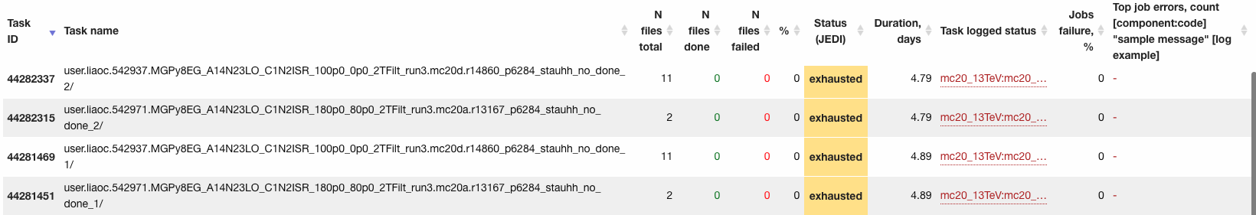
Production issues
100_0_mc20d, 180_80_mc20a
Submit them twice but still failed
1
Chengxin Liao
IHEP SUSY Meeting

Slide 23
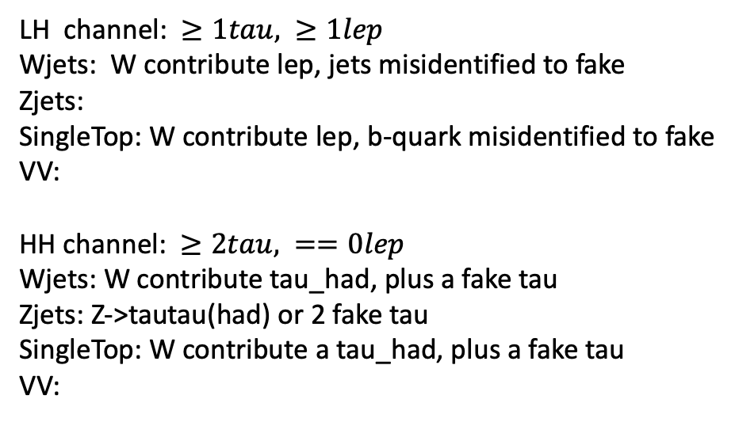
Bkg decay mode
LH channel: $≥1tau, ≥1lep$ Wjets: W contribute lep, jets misidentified to fake Zjets:
SingleTop: W contribute lep, b-quark misidentified to fake
VV: HH channel: $≥2tau, ==0lep$ Wjets: W contribute tau_had, plus a fake tau Zjets: Z->tautau(had) or 2 fake tau SingleTop: W contribute a tau_had, plus a fake tau VV:
Wjets: W->e/muon + nu W->tau+nu(can contribute true tau_had) jet misidentified to a fake tau Zjets: Z->ll/tautau jet misindentified to fake tau Top: top->W+b, W can contribute a true tau_had b-quark is a source of fake VV: W/Z
Chengxin Liao
IHEP SUSY Meeting

Slide 24
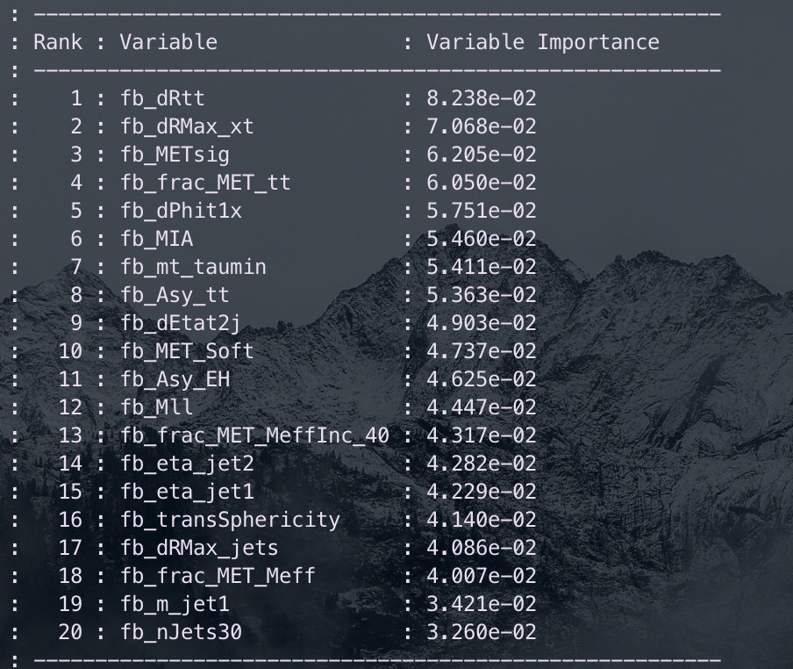
Multiclass(HH)
Hyperparameters: Ntrees = 200, MaxDepth = 6, MinNodeSize = 2%, Learning rate = 0.03(initial setting)
Feature engineering: Select a simple model and put all features into model, choose Top 30 vars based on importance list, drop high correlated vars Final feature list:
Weight choose: no weight, abs(weight)
No weight have better performance but abs(weight) fit our anaysis requirment
Split strategy: Separate entries by using mod 5, for Fake bkg, if separate follow sequence, all weighted entry will split into first fold
Chengxin Liao
IHEP SUSY Meeting

Slide 25
Multiclass(HH)
Class: C1N2, VV, Other_bkg
Hyperparameter tune: use optuna to auto-optimze
Test_auc = \sum{Test_auc_class} Train_auc = \sum{Train_auc_class}
constraint: average of AUC need to >= 0.6 penalty function: score = test_auc – 0.3*auc_gap (auc_gap = abs(train_auc- test_auc)) maximum(score)
After check some models, find C1N2 result is great, so the constraint and AUC calculation only in VV and Other bkg
Grid Search Ntrees: [200, 300, 400]
MaxDepth: [4, 6, 8, 10] MinNode: [1, 3, 5, 7]
Learning rate: [0.001, 0.005, 0.01, 0.05, 0.1]
Best one: Ntree=300, MaxDepth=6, MinNode=1%, Learning Rate=0.05
There still have rooms to optimize for lr
Chengxin Liao
IHEP SUSY Meeting

Slide 26
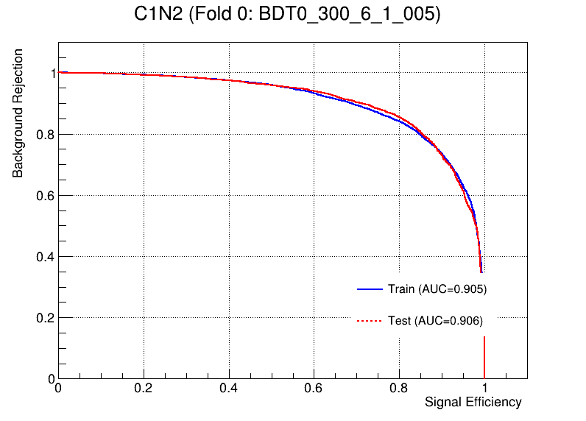
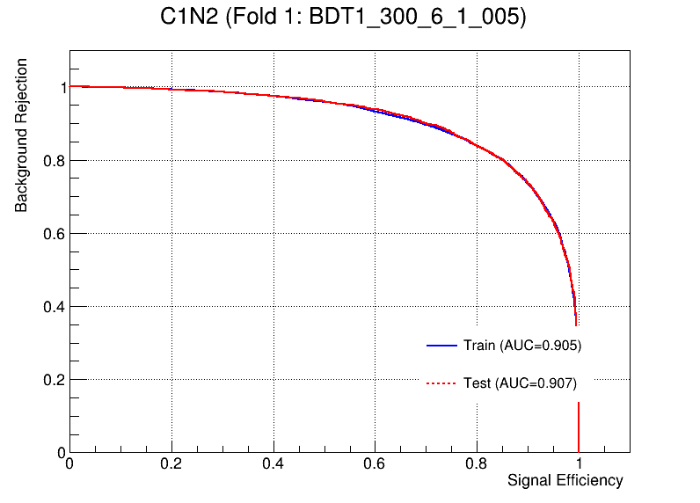
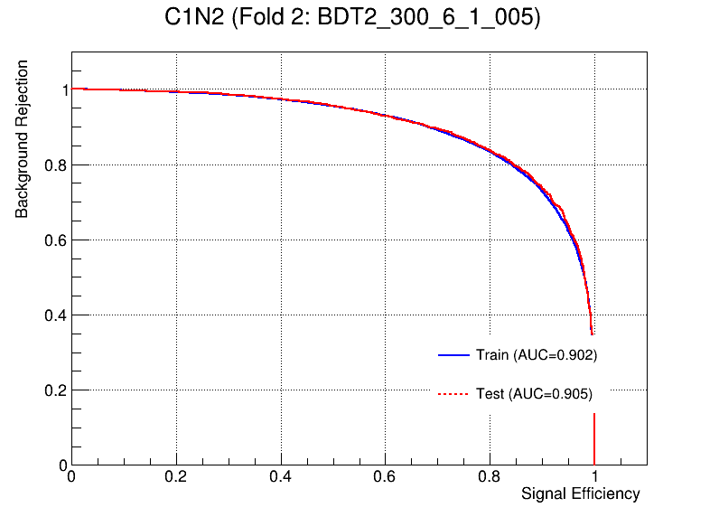
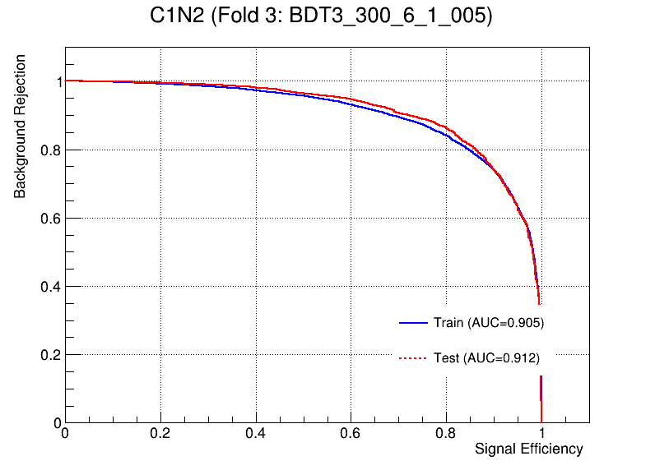
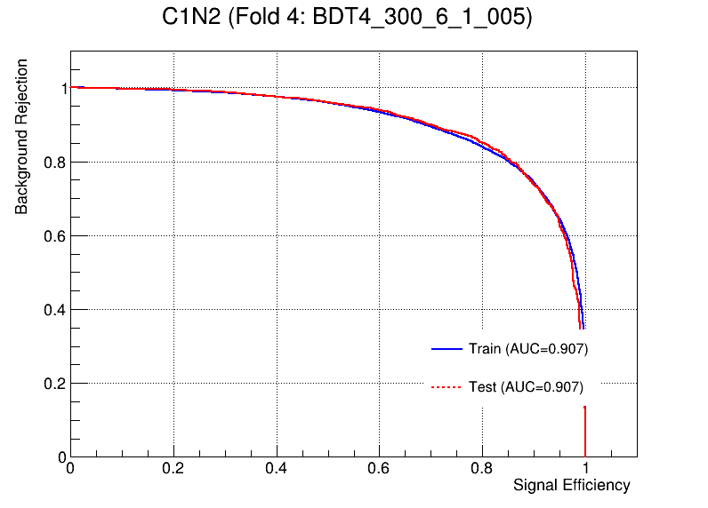
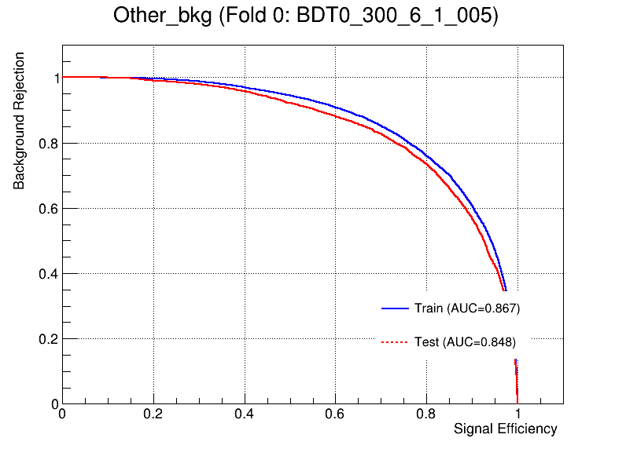
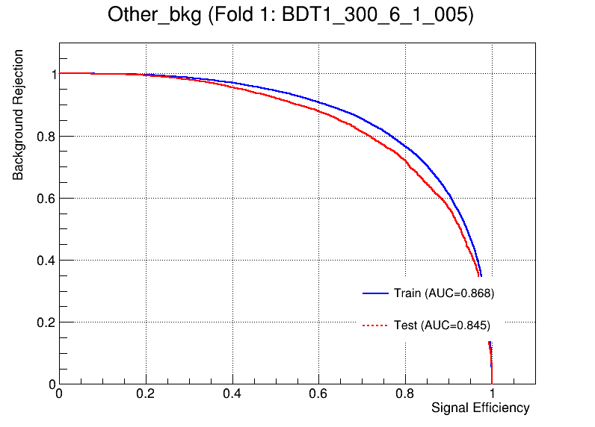

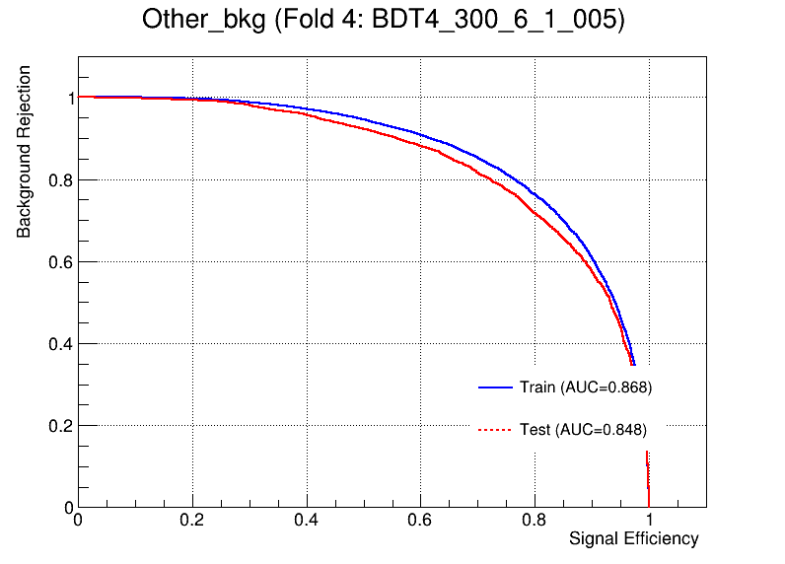
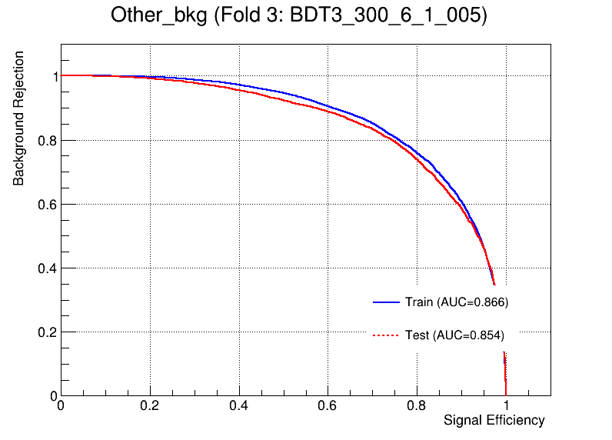
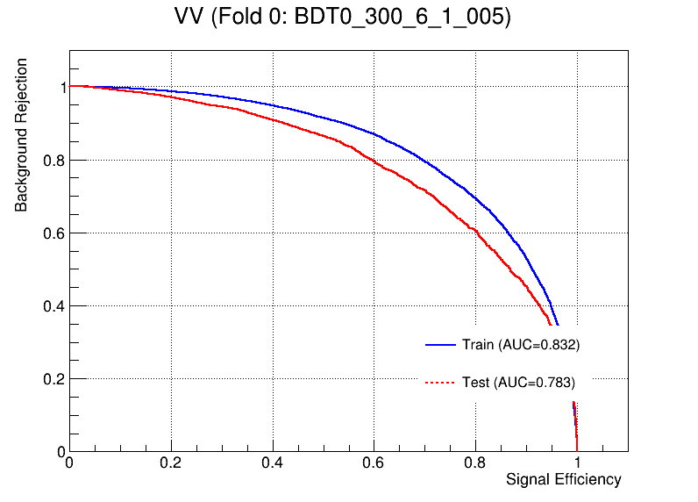
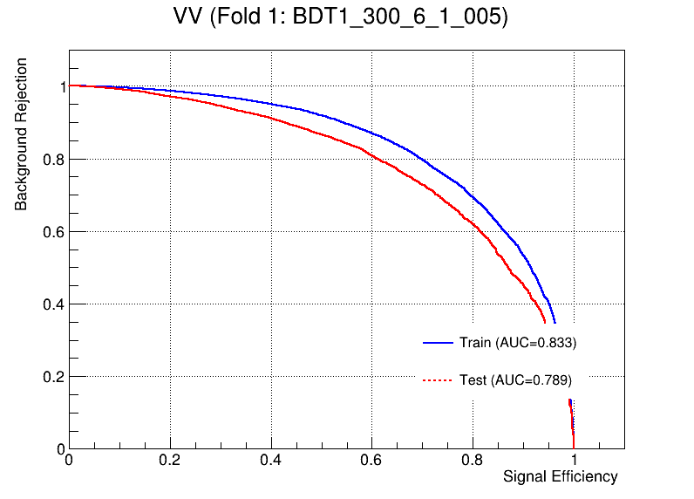
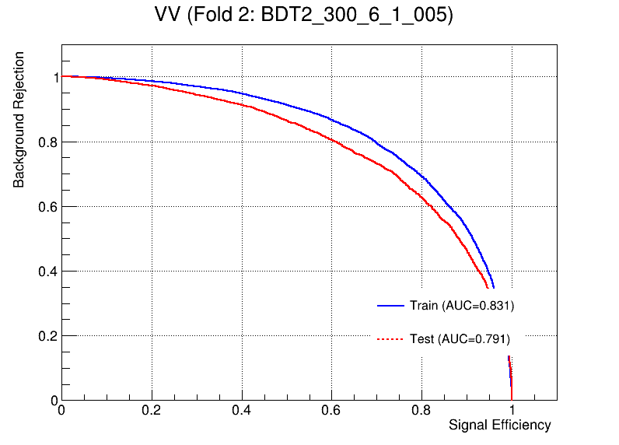


Multiclass(HH)
OverFit Check

Slide 27


SR(HH) Multi
50 bins
Each index stand for a region, and index 10 stands for sum
1
Chengxin Liao
IHEP SUSY Meeting

Slide 28
Zjets(HH)
== 2 medium tau == 0 lepton METtrig && MET >= 200 OS
bVeto nBaseJet >= 1
Jet pt > 100GeV C1N2 score <= 0.7(Othrogonal with SR)
CR: Mtt reco >= 80 && Mtt reco <= 110 VR: (Mtt reco >= 40 && Mtt reco < 80) || (Mtt reco > 110 && Mtt reco < 130)
Same with pre-selection
Region | TotalBkg | Zjets | purity | Data | Data/Bkg
CR | 1433.93+-11.003 | 1232.36+-5.476 | 0.859 | 1571 | 1.096
VR1 | 824.938+-8.468 | 674.307+-4.082 | 0.817 | 904 | 1.097
VR2 | 469.252+-7.834 | 321.877+-2.913 | 0.685 | 524 | 1.117
3
Chengxin Liao
IHEP SUSY Meeting

Slide 29
Top(HH)
== 2 medium tau == 0 lepton METtrig && MET >= 200 OS nBaseJet >= 1
Jet pt > 100GeV Mtt_reco < 40GeV && Mtt_reco > 130GeV
>= 1 bTag(improve top events)
C1N2 score <= 0.7(Othrogonal with SR) CR: ${270<M}_{T}\left(τ,MET\right)<400$ VR: $230<M_{T}\left(τ, MET\right)<270$
Same with pre-selection
Huge overestimation
Region | TotalBkg | Top | purity | Data | Data/Bkg
CR | 182.692+-5.738 | 140.981+-4.009 | 0.771 | 150 | 0.82
VR | 140.228+-5.236 | 103.866+-3.445 | 0.740 | 134 | 0.94
4
Chengxin Liao
IHEP SUSY Meeting

Slide 30


VV(HH)
Pre-selection && C1N2_score <= 0.7 && Max(score) == VV_score && VV_score >= 0.85
Region | TotalBkg | VV | purity | Data | Data/Bkg
VR | 32.4944+-2.09 | 15.4902 | 0.476 | 31 | 0.954
1
Chengxin Liao
IHEP SUSY Meeting

